Slide 1
IoT based Voice Controlled Home Assistance Hexapod
Nikhil Subramanian VIT University
Shanju shri M N VIT University
Rohitram V VIT University
Sriharipriya K C VIT University

Slide 2
Abstract
Introduction
Literature Survey
Problem Definition
Contents
Proposed Work
Methodology & Implementation
Results & Discussions
Conclusion
References

Slide 3
Abstract
This project aims to design a hexapod for helping people, especially old aged people or sick people at home.
Sensors are used to detect obstacles and the hexapod can choose a different path.
Electronic devices in each room are controlled through voice commands.
The robot also helps the user by carrying things like medicines, files, etc., to different areas in the home based on the given commands.
The home is monitored and the video will be live streamed for the user to monitor their home from anywhere at any time.

Slide 4
Introduction
IoT-assisted robotics applications are a palpable fact of our forthcoming future, thanks to the ongoing Internet of Things revolution and the rapid dispersion of robots in many activities of daily life.
IoT based Hexapod is one such application which can be used for various purposes from hospitals to the military.
This work aims to design a hexapod for helping people, especially old-aged or sick people at home with automation, voice based navigation and surveillance. The robot is also designed to help the user by carrying objects like medicines, files, etc., to various areas in the home based on the given commands.

Slide 5
Literature Survey
S No | Paper Title | Conference/Journal | Published in (year) | Technology used
1 | IOT Based Surveillance Robot | International Journal of Engineering Research & Technology | 2018 | Surveillance robot with metal detectors and a camera for live streaming. Cayenne software was used to control the robot both in manual and automatic mode.
2 | Design and Operation of a Novel Hexapod Robot for Surveillance Tasks | Advances in Service and Industrial Robotics | 2018 | Hybrid legged-wheeled mobile robot. Calculates optimum path planning trajectories based on the size of the obstacle and power consumption efficiency.
3 | Surveillance and Controlling of Firebird-V Based Hexapod using Raspberry Pi | IEEE International Conference for Innovation in Technology | 2020 | Wireless communication between Firebird-V based hexapod robot and the user using Raspberry Pi through WiFi. The activities of the robot are controlled by a webpage through Raspberry Pi.

Slide 6
Literature Survey
S No | Paper Title | Conference/Journal | Published in (year) | Technology used
4 | Centralized Multi-agent Mobile Robots SLAM and Navigation for COVID-19 Field Hospitals | 2nd Novel Intelligent and Leading Emerging Sciences Conference | 2020 | Fully autonomous centralized multi robot system for Covid-19 field hospitals which performs tasks like disinfecting, detecting remote body temperature..,
5 | Development of Hexapod Robot with Computer Vision | International Journal for Research in Applied Science & Engineering Technology | 2021 | Integration of robotic system with an embedded system of digital image processing.
6 | Prototype For Quadruped Robot Using IoT To Deliver Medicines And Essentials To Covid-19 Patient | International Journal of Advanced Research in Engineering and Technology | 2021 | Quadruped robot using IoT for delivering medicines and essentials to Covid-19 patients with ultrasonic sensors for obstacles detection.

Slide 7
Problem Definition
Hexapod robots have 3 pairs of legs to navigate through rough and uneven surfaces easily.
Each leg has 3 servo motors controlled by an arduino.
Google Assistant is used to accept voice commands from the user.
The camera attached to the hexapod helps in monitoring the home using video streaming.
Automation of electronics is done based on the commands given to the hexapod by the user using Adafruit and IFTTT platforms.

Slide 8
Proposed Work
The project aims at building an automated six legged hexapod that responds to voice commands to perform tasks.
The Lidar is used to collect data about the obstacles lying around the home while mapping the whole house.
Google Assistant intakes the voice commands given and processes it before passing it to the NodeMCU which then pushes the data over to the Adafruit Platform by using the MQTT protocol. Adafruit along with IFTTT platform is used to automate the electronics in the house based on the voice command received from the user.
Live video is also streamed for surveillance purposes.

Slide 9
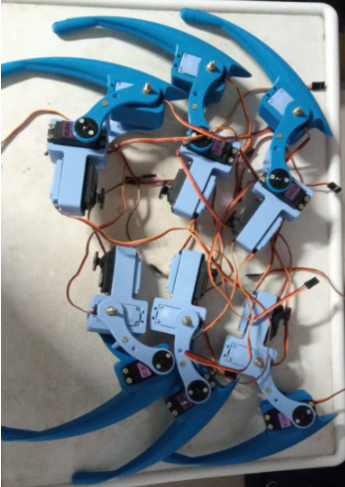
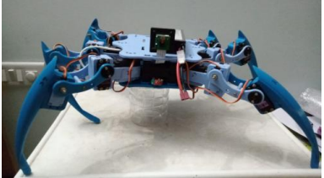
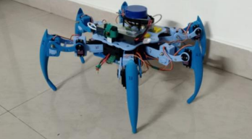
Methodology & Implementation
Assembling the hexapod and calibration
The parts of the six-legged robot like femur, base, thigh etc., are 3D printed.
Each leg is fitted with 3 MG996R servo motors which are controlled by the arduino.
Lidar is integrated with the robot for mapping purposes.
Raspbian and the ROS framework are installed in the Raspberry Pi, and the OS is configured in order to remotely connect the hexapod.
Legs of the hexapod
Partly Assembled hexapod

Slide 10
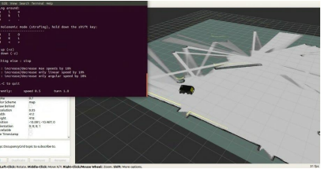
Methodology & Implementation
Mapping
The shortest distance between the start point and the target point is calculated using a map based planning method.
The detailed mapping of the house is done using a LIDAR mounted on the top of the hexapod.
The hexapod is manually operated using a joystick to navigate through the maze to draw a predefined map of the rooms.
The hexapod identifies the obstacles in each room and draws a path to avoid collision.

Slide 11
Methodology & Implementation
Surveillance and live streaming
The surveillance is done using a Raspberry Pi camera module.
The camera is set up and the video streaming web server is accessed at the Raspberry Pi’s IP address to monitor the house from anywhere and at any time.
Voice navigation and automation
Google Assistant linked to the users account is used for giving voice commands to the robot.
In the Adafruit platform a new dashboard named ‘Automation’ is created and two triggers are added to it.

Slide 12
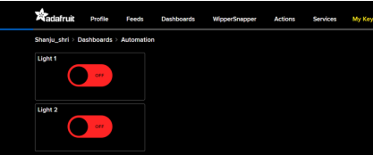
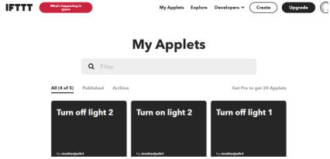
Methodology & Implementation
The NodeMCU is connected to the LEDs which represent the electronics in the rooms.
The data in the form of voice is then sent to the Adafruit platform through IFTTT.
This data is then used to automate the electronics connected to the system.

Slide 13
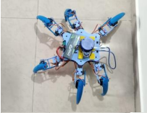
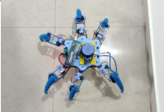
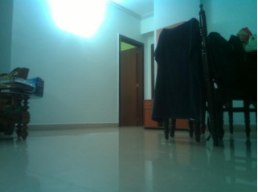
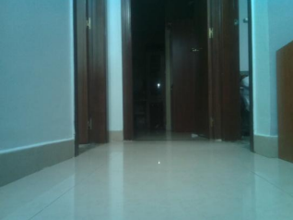
Results & Discussions
The hexapod reaches the target destination to work on the task given as command. The hexapod moves easily through rough terrains in a stable way.
The camera in the hexapod captures the images and video is streamed in the website. Thus the user can monitor the house from anywhere.

Slide 14
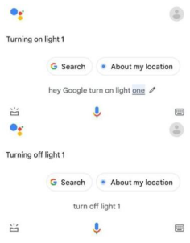
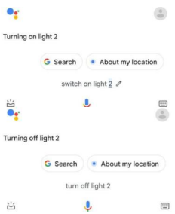
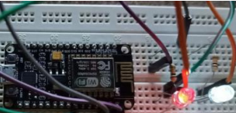
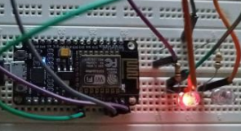
Results & Discussions
The voice commands are given using the Google Assistant to turn on the lights in the room. Google Assistant passes the commands to the system and responds to the given commands.
LEDs represent the electronics in the rooms. When the user commands the LEDs to turn ON and OFF, the tasks are performed accordingly.

Slide 15
Conclusion
The home assistance hexapod acts as a perfect companion and assistance for people at home, especially for sick and elderly people to meet their needs.
The main objective of this system is achieved by integrating the Internet of Things with robotics successfully.
The camera attached to the robot works effectively for monitoring the home even when the user is not at the site.
Voice controlled automation proves to make the hexapod more user-friendly.

Slide 16
References
Abdelrahman Sayed Sayed, Hossam Hassan Ammar and Rafaat 2halaby, “Centralized Multi-agent Mobile Robots SLAM and Navigation for COVID-19 Field Hospitals”, 2nd Novel Intelligent and Leading Emerging Sciences Conference, October 2020.
Abhilash Krishna et al. “Design and Fabrication of a Hexapod”, International Conference on Embedded Systems (ICES), 2014.
Abhishek C et al. “Development of Hexapod Robot with Computer Vision”, International Journal for Research in Applied Science & Engineering Technology (IJRASET), Vol. 9, Volume 8, August 2021.
Aishwarya K Telkar et al. “IoT Based Smart Multi Application Surveillance Robot”, Second International Conference on Inventive Research in Computing Applications (ICIRCA), 2020.
Anita Chaudhari, Jeet Thakur and Pratiksha Mhatre, “PROTOTYPE FOR QUADRUPED ROBOT USING IoT TO DELIVER MEDICINES AND ESSENTIALS TO COVID-19 PATIENT ”, International Journal of Advanced Research in Engineering and Technology (IJARET), Vol. 12, Issue 5, May 2021
Aqeel-ur-Rehman, Royda Arif and Hira Khursheed, “Voice Controlled Home Automation System for the Elderly or Disabled People”, Journal of Applied Environmental and Biological Sciences, 2014.

Slide 17
References
Feng Zhang, Shidong Zhang, Qian Wang , Yujie Yang and Bo Jin, “Straight Gait Research of a Small Electric Hexapod Robot”, Applied Sciences, 2021.
Fernando Gomez-Bravo, Pablo Villadoniga, and Giuseppe Carbone, “Design and Operation of a Novel Hexapod Robot for Surveillance Tasks”, Advances in Service and Industrial Robotics, 2018.
G. Anandravisekar et al. “IOT Based Surveillance Robot ”, International Journal of Engineering Research & Technology (IJERT), Vol. 7 Issue 03, March 2018.
Jing Qi, et al. “Fusing Hand Postures and Speech Recognition for Tasks Performed by an Integrated Leg-Arm Hexapod Robot”, Applied Sciences, 2020.
Joana Coelho, Fernando Ribeiro, Bruno Dias, Gil Lopes and Paulo Flores, “Trends in the Control of Hexapod Robots: A Survey”, Robotics, 2021.

Slide 18
Thank You

